Slide 1
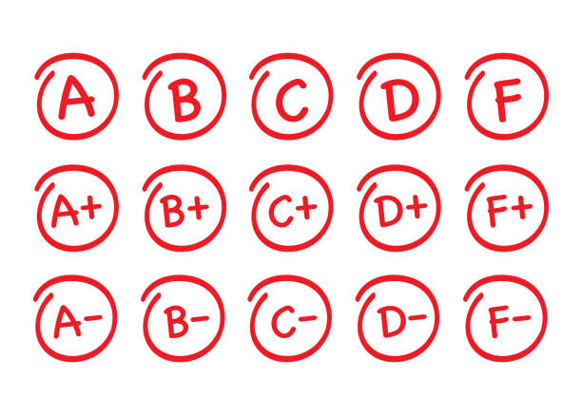
Student Grade Calculator
Presented by –
Group 16
46. Omkar Vitthal Savant
47. Diksha Pravin Sawant
48. Om Vilas Shimpi

Slide 2
Introduction
Client Side Scripting
JavaScript
HTML

Slide 3

Client Side Scripting
Client-side scripting simply means running scripts, such as JavaScript, on the client device, usually within a browser.
All kinds of scripts can run on the client side if they are written in JavaScript, because JavaScript is universally supported.

Slide 4

JavaScript
JavaScript, often abbreviated JS, is a programming language that is one of the core technologies of the World Wide Web, alongside HTML and CSS.
Over 97% of websites use JavaScript on the client side for web page behavior, often incorporating third-party libraries.

Slide 5

HTML
The HyperText Markup Language, or HTML is the standard markup language for documents designed to be displayed in a web browser.
It can be assisted by technologies such as Cascading Style Sheets and scripting languages such as JavaScript

Slide 6

History
Client Side Scripting
JavaScript
HTML

Slide 7

Client-Side Scripting
Dec. 1994
Netscape introduced an implementation of JavaScript for server-side scripting with Netscape Enterprise Server, first released in December, 1994.
early 1995
Server-side scripting was later used in early 1995 by Fred DuFrense while developing the first website for Boston.

Slide 8

JavaScript
JavaScript was invented by Brendan Eich in 1995.
It was developed for Netscape 2, and became the ECMA-262 standard in 1997.
After Netscape handed JavaScript over to ECMA, the Mozilla foundation continued to develop JavaScript for the Firefox browser.

Slide 9

HTML
HTML was created by Sir Tim Berners-Lee in late 1991 but was not released officially, published in 1995 as HTML 2.0.
HTML 4.01 was published in late 1999 and was a major version of HTML.
HTML is a very evolving markup language and has evolved with various versions updating.

Slide 10
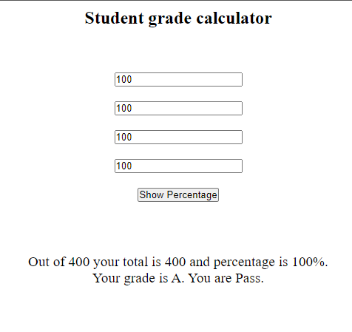
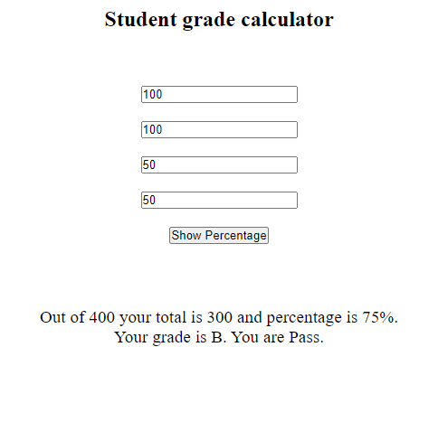
Output

Slide 11
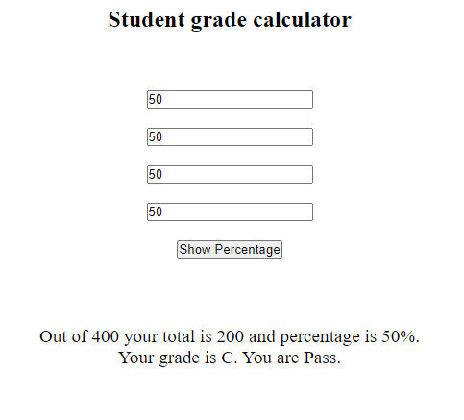
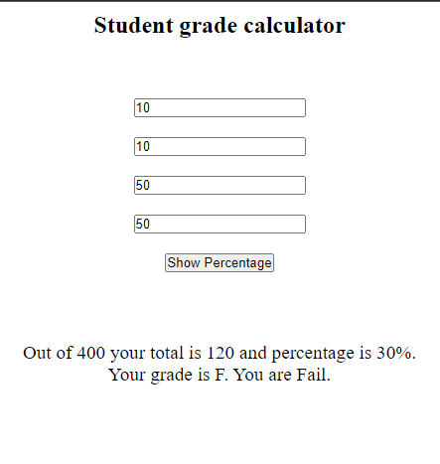
Output

Slide 12
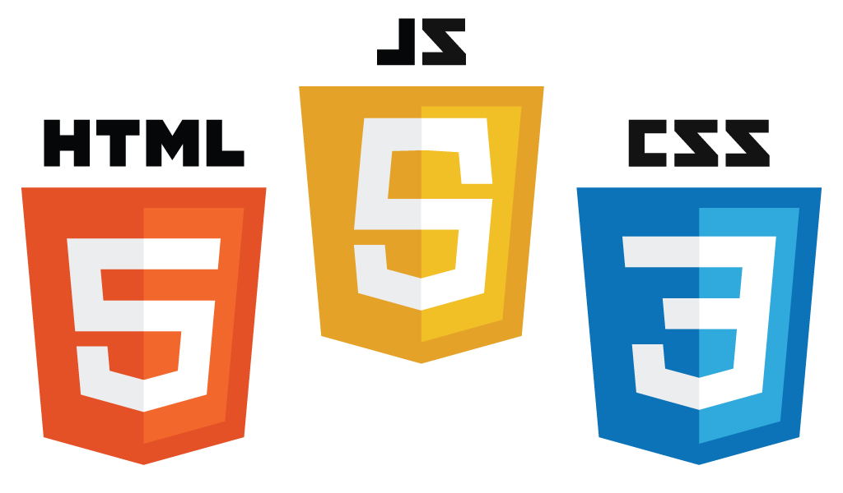
Conclusion
By implementing Grade Calculator as a topic we have learned several concepts of Client Side Scripting.
A use of JavaScript loops and switches were used.
Also use of Cascading Style Sheets and HTML were used.

Slide 13

Thank You!

